Slide 1
Fundamentals of Python: First Programs Second Edition
Chapter 3
Loops and Selection Statements

Slide 2
Objectives (1 of 2)
3.1 Write a loop to repeat a sequence of actions a fixed number of times
3.2 Write a loop to traverse the sequence of characters in a string
3.3 Write a loop that counts down and a loop that counts up
3.4 Write an entry-controlled loop that halts when a condition becomes false

Slide 3
Objectives (2 of 2)
3.5 Use selection statements to make choices in a program
3.6 Construct appropriate conditions for condition-controlled loops and selection statements
3.7 Use logical operators to construct compound Boolean expressions
3.8 Use a selection statement and a break statement to exit a loop that is not entry-controlled

Slide 4
Definitive Iteration: The for Loop
Repetition statements (or loops) repeat an action
Each repetition of action is known as pass or iteration
Two types of loops
Those that repeat action a predefined number of times (definite iteration)
Those that perform action until program determines it needs to stop (indefinite iteration)

Slide 5
Executing a Statement a Given Number of Times (1 of 3)
Python’s for loop is the control statement that most easily supports definite iteration
>>>for x in range(4):
print(“It’s alive!”, end = “ ”) # The end = “ “ means that the cursor won’t go to the next line
# after each print
It’s alive! It’s alive! It’s alive! It’s alive!
The form of this type of loop is:
For <variable> in range(<an integer expression>):
<statement-l>
.
.
<statement-n>
First line of code is sometimes called loop header
Rest of code is loop body (must be indented and aligned in the same column)

Slide 6
Executing a Statement a Given Number of Times (2 of 3)
Example: Loop to add up the numbers between 0 and 5
sum = 0
for a in range(6):
sum = sum + a
print(“Sum is “, sum)
Output:
Sum is 15
If the exponent were 0, the loop body would not execute, and value of product would remain as 1

Slide 7
Executing a Statement a Given Number of Times (3 of 3)
Example: Loop to compute a to the power of ex
>>> a = 2
>>> ex = 3
>>> result = 1
>>> for eachPass in range(ex)
result = result * a
print(result, end = “ ”)
2 4 8
>>>> product
8
If the exponent were 0, the loop body would not execute, and value of product would remain as 1

Slide 8
Count-Controlled Loops (1 of 2)
Loops that count through a range of numbers
>>> product = 1
>>> for count in range (4):
product = product * (count + 1)
>>> product
24
To specify an explicit lower bound:
>>> product = 1
>>> for count in range (1, 5):
product = product * count
>>> product
24

Slide 9
Count-Controlled Loops (2 of 2)
Output
Enter the lower bound: 1
Enter the upper bound: 10
Sum is: 55
Example: bound-delimited summation
lower = int(input(“Enter the lower bound: ”))
upper = int(input(“Enter the upper bound: ”))
sum = 0
for number in range(lower, upper + 1):
sum = sum + number
print (“\nSum is: “, sum)

Slide 10
Loop Errors: Off-by-One Error
Example:
# Count from 1 through 4, we think
>>>for count in range(1,4):
print(count)
1
2
3
Loop actually counts from 1 through 3
Not a syntax error, but rather a logic error

Slide 11
Traversing the Contents of a Data Sequence
range returns a list
>>> list(range(4))
[0, 1, 2, 3]
>>> list(range(1, 5))
[1, 2, 3, 4]
Strings are also sequences of characters
Values in a sequence can be visited with a for loop:
for <variable> in <sequence>:
<do something with variable>
Example:
>>> for character in “Hi there!”:
print(character, end = “ ”)
H i t h e r e !

Slide 12
Specifying the Steps in the Range
range expects a third argument that allows you specify a step value
>>> list(range(1, 6, 1)) # Same as using two arguments
[1, 2, 3, 4, 5]
>>> list(range(1, 6, 2)) # Use every other number
[1, 3, 5]
>>> list(range(1, 6, 3)) # Use every third number
[1, 4]
Example:
sum = 0
for count in range(2, 11, 2):
sum += count
print (sum)
Output would be 30

Slide 13
Loops that Count Down
Example:
>>> for count in range(10, 0, −1):
print(count, end = " ")
10 9 8 7 6 5 4 3 2 1
>>> list(range(10, 0, −1))
[10, 9, 8, 7, 6, 5, 4, 3, 2, 1]

Slide 14
Augmented Assignment (Shortcut Operators)
The assignment symbol can be combined with the arithmetic and concatenation operators to provide augmented assignment operations:
a = 17
s = “hi”
a += 3 #Equivalent to a = a + 3
a −= 3 #Equivalent to a = a − 3
a *=3 #Equivalent to a = a * 3
a /= 3 #Equivalent to a = a / 3
a //= 3 #Equivalent to a = a // 3
a %= 3 #Equivalent to a = a % 3
s += “ there” #Equivalent to s = s + “ there”
Format: <variable> <operator>= <expression>
Equivalent to: <variable> = <variable> <operator> <expression>

Slide 15
Formatting Text for Output (1 of 3)
Many data-processing applications require output that has tabular format
Field width: Total number of data characters and additional spaces for a datum in a formatted string
The print function automatically begins printing an output datum in the first available column
>>> for exponent in range(7, 11):
print(exponent, 10 ** exponent)
7 10000000
8 100000000
9 1000000000
10 10000000000

Slide 16
Formatting Text for Output (2 of 3)
<format string> % <expression>
This version contains format string, format operator %, and single data value to be formatted
To format integers, use %d
To format strings use %s
To format sequence of data values:
<format string> % (< expression −1>, ..., < expression −n>)
>>> for exponent in range(7, 11):
print("%-3d%12d" % (exponent, 10 ** exponent))
7 10000000
8 100000000
9 1000000000
10 10000000000

Slide 17
Formatting Text for Output (3 of 3)
To format data value of type float:
%<field width>.<precision>f
where .<precision> is optional
Examples:
>>> salary = 100.00
>>> print(“Your salary is $” + str(salary))
Your salary is $100.0
>>> print(“Your salary is $%0.2f” % salary)
Your salary is $100.00

Slide 18
Selection: If and If-Else Statements
Selection statements allow a computer to make choices
Based on a condition
# compute the absolute value of x
x = int (input("Enter a number: "))
if x < 0:
x = -x # this statement only happens if x is less than 0
print (x)

Slide 19
The Boolean Type, Comparisons, and Boolean Expressions
Boolean data type consists of two values: true and false (typically through standard True/False)
Example: 4 != 4 evaluates to False
Comparison Operator | Meaning
== | Equals
!= | Not equals
< | Less than
> | Greater than
<= | Less than or equal
>= | Greater than or equal

Slide 20
If-Else Statements (1 of 2)
Also called a two-way selection statement
Often used to check inputs for errors:
import math
area = float(input(“Enter the area: ”))
if area > 0:
radius = math.sqrt(area / math.pi)
print(“The radius is”, radius)
else:
print(“Error: the area must be a positive number”)
Syntax:
if <condition>:
<sequence of statements–1> # must be indented
else:
<sequence of statements-2 > # must be indented

Slide 21
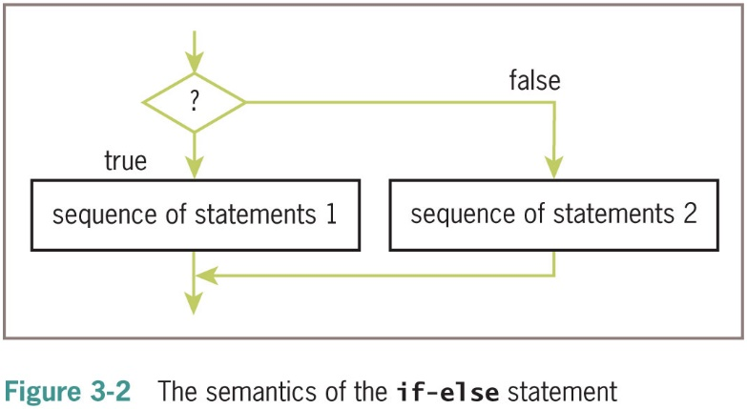
If-Else Statements (2 of 2)

Slide 22
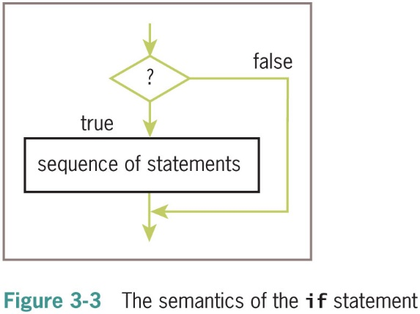
One-Way Selection Statements
Simplest form of selection is the if statement
if <condition>:
<sequence of statements > // must be indented
x = int (input("Enter a number: "))
if x < 0:
x = -x
print (x)

Slide 23
Multi-Way If Statements (1 of 3)
A program may be faced with testing conditions that entail more than two alternative courses of action
Can be described in code by a multi-way selection statement
Letter Grade | Range of Numeric Grades
A | All grades above 89
B | All grades above 79 and below 90
C | All grades above 69 and below 80
F | All grades below 70

Slide 24
Multi-Way If Statements (2 of 3)
Example:
number = int(input(“Enter the numeric grade: ”))
if number > 89:
letter = ‘A’
elif number > 79:
letter = ‘B’
elif number > 69:
letter = ‘C’
else:
letter = ‘F’
print(“The letter grade is”, letter)
Syntax:
if <condition-1>:
<sequence of statements-1>
elif <condition-n>:
<sequence of statements-n>
else:
<default sequence of statements>

Slide 25
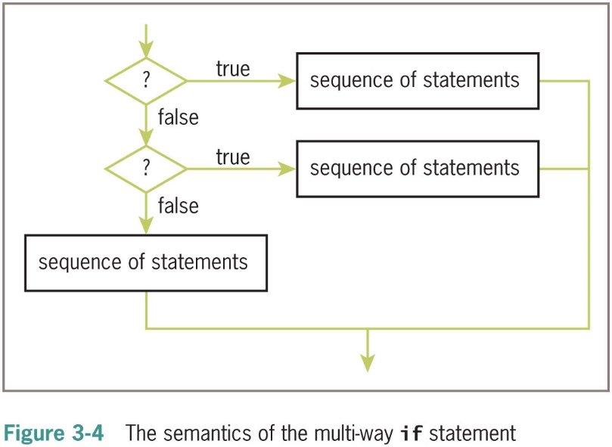
Multi-Way If Statements (3 of 3)

Slide 26
Logical Operators
Practice 1: Finding even numbers or numbers divisible by 5
Practice 2: calculate imaginary college’s tuition based on county residency and state residency.
In county: $50.00 / hour
In state: $100.00 / hour
Out of state: $150.00 / hour
International: $300.00/hour
Practice 3: Make a loop with an if statement inside

Slide 27
Logical Operators and Compound Boolean Expressions
Often a course of action must be taken if either of two conditions is true: Below are two approaches
number = int(input(“Enter the numeric grade: ”))
if number > 100:
print(“Error: grade must be between 100 and 0”)
elif number < 0:
print(“Error: grade must be between 100 and 0”)
else:
# The code to compute and print the result goes here
Simplified Code:
number = int(input(“Enter the numeric grade: ”))
if number > 100 or number < 0:
print(“Error: grade must be between 100 and 0”)
else:
# The code to compute and print the result goes here

Slide 28


Logical Operators
Operator | Example | It’s only true if…..
and | (condition 1 and condition2) | condition1 AND condition2 are both true
or | (condition 1 or condition2) | either condition1 OR condition2 is true (or both)
not | not (condition1) | This gives you the opposite of condition1
I want BOTH!
I'm not picky
Reverse it!

Slide 29
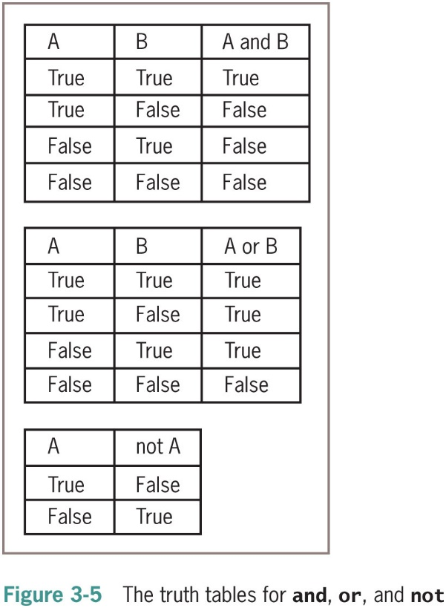
Logical Operators and Compound Boolean Expressions

Slide 30
Logical Operators
a = 85
b = -25;
if a >= 90 and b < 0:
print(a)
elif a >= 90 or b > 0:
print(b)
elif not (a <= 70) :
print(a+b)
else:
print("None of the above")

Slide 31
Logical Operators
if (14 >= 5) and ('A' < 'B') if ('A' < 'D’) or (7 != 7)
if (24 >= 35) and ('A' < 'B') if not ('A' > 'B’)
if (14 >= 5) or ('A' > 'B') if not (6 <= 7)
if (24 >= 35) or ('A' > 'B’)

Slide 32
Logical Operators and Compound Boolean Expressions
Next example verifies some of the claims made in the previous truth tables:
>>> A = True
>>> B = False
>>> A and B
False
>>> A or B
True
>>> not A
False
The logical operators are evaluated after comparisons but before the assignment operator
not has higher precedence than and and or (so not happens before and or or)

Slide 33
Logical Operators and Compound Boolean Expressions
Type of Operator | Operator Symbol
Exponentiation | **
Arithmetic negation | −
Multiplication, division, remainder | *, /, %
Addition, subtraction | +, −
Comparison | ==, !=, <, >, <=, >=
Logical negation | not
Logical conjunction | and
Logical disjunction | or
Assignment | =

Slide 34
Order of Precedence
found = True;
age = 20
count = 20;
ch = 'B'
print(age > 18 or count < 15 and ch == 'b’)
print((age > 18 or count < 15) and (ch == 'b') or not found)

Slide 35
Short-Circuit Evaluation
In (A and B), if A is false, then so is the expression, and there is no need to evaluate B
In (A or B), if A is true, then so is the expression, and there is no need to evaluate B
Short-circuit evaluation: Evaluation stops as soon as possible
Example:
count = int(input(“Enter the count: ”))
theSum = int(input(“Enter the sum: ”))
if count > 0 and theSum // count > 10:
print(“average > 10”)
else:
print(“count = 0 or average <= 10”)

Slide 36
Testing Selection Statements
Tips:
Make sure that all of the possible branches or alternatives in a selection statement are exercised
After testing all of the actions, examine all of the conditions
Test conditions that contain compound Boolean expressions using data that produce all of the possible combinations of values of the operands

Slide 37
Conditional Iteration: The while Loop
The while loop can be used to describe conditional iteration
Example: A program’s input loop that accepts values until user enters a sentinel that terminates the input

Slide 38
The Structure and Behavior of a While Loop (1 of 3)
Conditional iteration requires that condition be tested within loop to determine if it should continue
Called continuation condition (I call it the go condition)
Syntax:
while <condition>:
<sequence of statements>
Improper use may lead to infinite loop
while loop is also called entry-control loop
Condition is tested at top of loop
Statements within loop can execute zero or more times

Slide 39
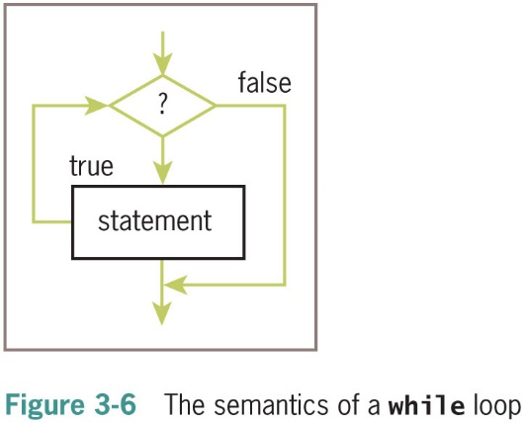
The Structure and Behavior of a While Loop (2 of 3)

Slide 40
The Structure and Behavior of a While Loop (3 of 3)
Example:
theSum = 0.0
data = input(“Enter a number or just enter to quit: ”)
while data != “”:
number = float(data)
theSum += number
data = input(“Enter a number or just enter to quit: ”)
print(“The sum is”, theSum)
Output
Enter a number or just enter to quit: 3
Enter a number or just enter to quit: 4
Enter a number or just enter to quit: 5
Enter a number or just enter to quit:
The sum is 12.0
data is the loop control variable
first input statement initializes a variable to a value that the loop condition can test

Slide 41
Count Control with a While Loop
Use a while loop for a count-controlled loop
# Summation with a for loop
theSum = 0
for count in range(1, 100001):
theSum += count
print(theSum)
# Summation with a while loop
theSum = 0
count = 1
while count <= 100000:
theSum += count
count += 1
print(theSum)

Slide 42
The break Statement
The break statement will cause an exit from the loop
sum = 0.0
count = 0
while count <= 4:
value = float(input("Enter a grade: "))
if value < 0:
print("Error – grades cannot be negative.")
break
sum += value
count += 1
print("The sum is", sum)
average = sum / count
print("Average is ", average)

Slide 43
Random Numbers (1 of 2)
Programming languages include resources for generating random numbers
random module supports several ways to do this
randint returns random number from among numbers between two arguments, both included
So, in the example below, the random number will be between 1 and 6
>>> import random
>>> for roll in range(10):
print(random.rand int(1, 6), end = “ ”)
2 4 6 4 3 2 3 6 2 2

Slide 44
Random Numbers (2 of 2)
Example: A simple guessing game
import random
randNumber = random.randint(1, 10)
count = 0
userNumber = 0
while (userNumber != randNumber):
count += 1
userNumber = int(input("Enter your guess: "))
if userNumber == randNumber:
print("Congratulations! You've got it in", count, "tries!")

Slide 45
Loop Logic, Errors, and Testing
Errors to rule out during testing while loop:
Incorrectly initialized loop control variable
Failure to update this variable correctly within loop
Failure to test it correctly in continuation condition
To halt loop that appears to hang during testing, type Control+c in terminal window or I D L E shell

Slide 46
Chapter Summary (1 of 3)
Control statements determine order in which other statements are executed in program
Definite iteration is process of executing set of statements fixed, predictable number of times
Example: use for loop
for loop consists of header and set of statements called body
Can be used to implement a count-controlled loop
Use range to generate sequence of numbers
Can traverse and visit the values in any sequence

Slide 47
Chapter Summary (2 of 3)
A format string and its operator % allow programmer to format data using field width and precision
An off-by-one error occurs when loop does not perform intended number of iterations, there being one too many or one too few
Boolean expressions evaluate to True or False
Constructed using logical operators: and, or, not
Python uses short-circuit evaluation in compound Boolean expressions
Selection statements enable program to make choices

Slide 48
Chapter Summary (3 of 3)
if-else is a two-way selection statement
Conditional iteration is the process of executing a set of statements while a condition is true
Use while loop (which is an entry-control loop)
A break can be used to exit a loop from its body
Any for loop can be converted to an equivalent while loop
Infinite loop: Continuation condition never becomes false and no other exit points are provided
random.rand int returns a random number

